Slide 1
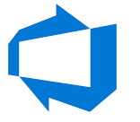





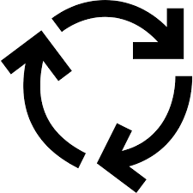
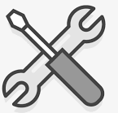

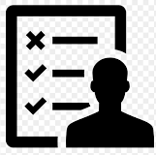
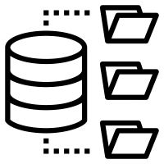


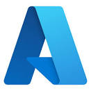
DevOps Lifecycle
Customer comes with requirements
Business analysts/product owner translates requirements into smaller units called backlogs
Developers picks up backlog items/bugs and starts development
Engineering team/SCRUM master does the capacity planning and sprint planning
Once developers finish the code, they
Build and test in their local
Get it reviewed
Commits the code to central repo
Business users test UAT environment
If they find any expectation mismatch then report it to product owner
Testing team does test planning
Testing team tests the deployments and logs defects
Once testing team is satisfied they promote the deployment to UAT
Central
Repo
Once business team is satisfied they promote the deployment to PROD
PROD
VMs
Kubernetes
PAAS Services
UAT
VMs
Kubernetes
PAAS Services
DEV
VMs
Kubernetes
PAAS Services
Deployment Environments
Build and test in central place with the entire code
Save the build output in central place
Stage wise deploy

Slide 2
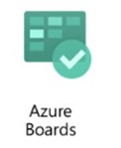
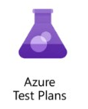
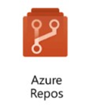
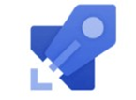
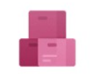
DevOps Lifecycle
Customer comes with requirements
Business analysts/product owner translates requirements into smaller units called backlogs
Developers picks up backlog items/bugs and starts development
Azure Boards
Engineering team/SCRUM master does the capacity planning and sprint planning
Once developers finish the code, they
Build and test in their local
Get it reviewed
Commits the code to central repo
Business users test UAT environment
If they find any expectation mismatch then report it to product owner
Testing team does test planning
Testing team tests the deployments and logs defects
Once testing team is satisfied they promote the deployment to UAT
Azure
Repo
Azure Test Plans
Once business team is satisfied they promote the deployment to PROD
PROD
VMs
Kubernetes
PAAS Services
UAT
VMs
Kubernetes
PAAS Services
DEV
VMs
Kubernetes
PAAS Services
Azure
Build
Pipelines
Deployment Environments
Build and test in central place with the entire code
Save the build output in central place
Stage wise deploy
Azure Release Pipelines
Azure Artifacts

Slide 3
Features of Azure DevOps
Azure Boards delivers a suite of Agile tools to support planning and tracking work, code defects, and issues using Kanban and Scrum methods
Azure Repos provides Git repositories or Team Foundation Version Control (TFVC) for source control of your code.
Azure Pipelines provides build and release services to support continuous integration and delivery of your apps.
Azure Artifacts allows teams to share Maven, npm, and NuGet packages from public and private sources and integrate package sharing into your CI/CD pipelines.
Azure Test Plans provides several tools to test your apps, including manual/exploratory testing and continuous testing.

Slide 4
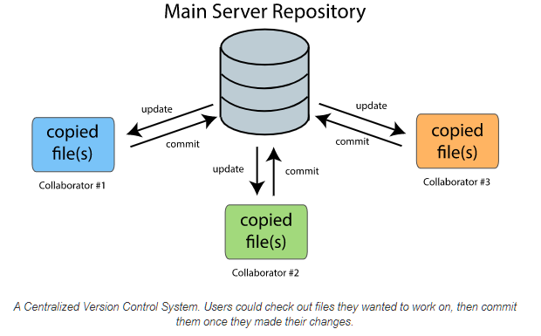
Centralized version control (TFVC)

Slide 5
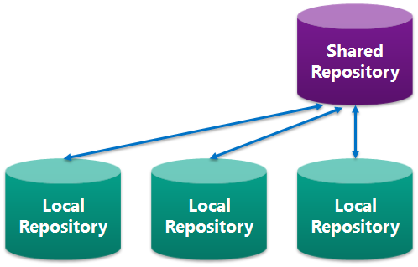
Centralized version control (git)

Slide 6
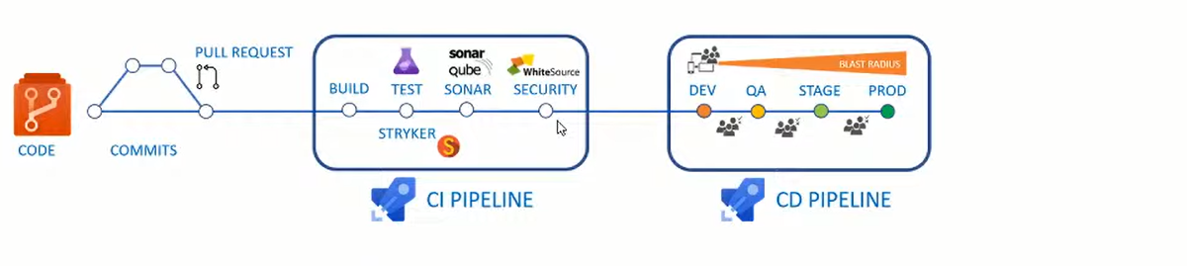
CI/CD Overview

Slide 7
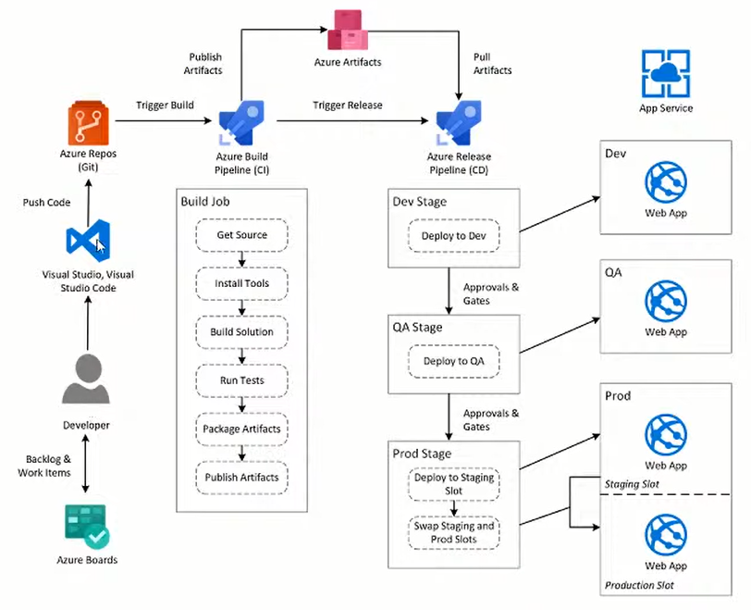
CI/CD Lifecycle

